Slide 1
Current: $108.96 Target: $140.45 (+28.9%) Time Horizon: 12-24 Months
Taiwan Semiconductor Manufacturing Co. (NYSE: TSM)
Industry Director: Ray Hatton
Analysts: Benjamin Chan, Bricen Fisher, Nirmal Malhotra
Junior Analyst: Samir Syed

Slide 2
Company Overview
Business Description
2020 Revenue by Technology
Taiwan Semiconductor is based out of Taiwan and established in 1987 by Morris Chang
World's largest pure-play semiconductor foundry
TSM manufactures semiconductors for brands such as AMD, Apple, NVIDIA, Qualcomm, etc.
TSM does not design their chips, only manufacture
Serving customers that operate in 175+ countries reaching 1+ billion people
Operating fabs in China, Taiwan, and U.S.
Business Highlights
Revenue Breakdown
TSM is opening a fab in Phoenix, AZ expected to generate 120k+ wafers annually for the U.S.
TSM has faced 165% YoY stock growth and exponential revenue growth of 25% in 2020
Apple’s move away from Intel has immensely benefitted TSM with expected growth of 5%
Expected total dividend of $1.42 per share
Over 20% increase in R&D YoY shows TSM’s ambition in implementing new technologies
Sources: Investor Presentation, Company Filings, CNBC, Forbes

Slide 3
Financial Overview
52 Week Price Chart
Enterprise Value Walkthrough
$ in Millions
Share Price | $109
Shares Outstanding | 5.2B
Equity Value | $541.1B
Cash & Short-Term Investments | 24.8B
Total Debt | 12.2M
Preferred Equity | -
Minority Interest | 34M
Enterprise Value | $524.6B
Financial Highlights
Key Metrics
1. Intel’s manufacturing struggles
Intel announced a delay in the next generation of 7nm semiconductors allowing TSM to gain market share
2. New Intel CEO announces in house manufacturing decreasing share price
Intel’s struggles developing the next generation of chips led to speculation of outsourcing to TSM
3. New presidential administration
The market went on an uptrend as Joe Biden became president indicating better trade relations with other nations
Market Cap | $541.11B
52 Week Range | $46.30 - $142.20
LTM EV/EBITDA | 16.70x
LTM Gross Profit Margin | 53.10%
LTM P/E | 29.70x
Beta | 0.96
3

Slide 4
Industry Overview
Going Smaller
Global Semiconductor Market Size ($B)
TSM’s 5nm chip is 22% faster, and consumes 30% less energy compared to 7nm counterpart
Chip manufacturing is difficult and on average requires $4B+ in initial cost and billions in R&D
Companies are moving towards semiconductors 5nm and smaller, yet players like intel struggle
Smaller semiconductors increase output for the same quantity of wafers used
Ex. 1000 chips on 10nm but 2000 chips on 5nm
CAGR 10.0%
Advancing Technology
Micro LED Display Market Size ($M)
EVs will drive semiconductor demand as the EV market grows to $800B+ globally by 2027
Ex. Battery management, safety systems, internal infotainment, autonomous driving computers, etc.
The IoT market growing to $6B+ globally will make semiconductors more relevant than ever
Ex. Home appliances, RC toys, LED bulbs, smart cites and more will be reliant on semiconductors
The cloud computing market size will reach $1T+ by 2026 increasing demand for semiconductors
240M+ estimated smartphone shipments in 2021
CAGR 89.3%
4

Slide 5
Investment Rationale
TSM is a direct beneficiary of high-growth industries leading to increased future demand
Companies have a hard time moving their products to a competing foundry due to unique customizations and increased cost
Smartphone, HPC, and IoT segments increased 23%, 39% and 28% while DCE and auto dropped
TSM will capture more demand than competitors due to large customer base of over 500 companies and relationship with industry leaders
TSM customers’ projected revenue growth will directly correlate to increased demand for TSM
Leading tech capabilities provide sustainable competitive advantage & increased demand
TSM were the first to release 5nm technology and are at least one generation ahead of competitors
2021 guidance estimates CapEx of between $25B-$28B which indicates a 45%-63% YoY increase
Apple already ordered all TSM’s 3nm technology which is starting risk production in 2021
TSM looking to expand into other markets and opportunities including augmented reality devices
Industry Growth CAGR to 2025
OLED Micro Display Market Growth ($M)
CAGR 27.7%
Sources: Earnings Call Transcript, SeekingAlpha, WSJ, Globe Newswire, Mordor Intelligence, Nikkei Asia

Slide 6
Investment Rationale
Chip shortage shows heavy reliance on TSM and proves TSM’s pricing power
TSM is one of the biggest beneficiaries of the chip shortage with capacity 100% booked until the fall
TSM’s market share grows as they record rising gross margins which shows that companies are still going to TSM despite price increases
TSM still sees high demand amidst recently terminating discounts and raising prices 10%-15%
Considering another price hike in the near future
TSM’s operational excellence and competitive moat leads to lasting & effective pricing power
Semiconductor companies that could manufacture their own chips are some of TSM’s largest clients
Intel, world leader in chip-making technology, plans to outsource their flagship CPUs with TSM
Only one competitor (Samsung) that can manufacture the 5-nanometer technology
Samsung’s foundry has 2.3x less capacity than TSM and 60% of capacity are for internal use
TSM invests $28B on increasing monthly capacity by at least 20,000 chips to capture future demand
TSM’s Market Share and Margin Growth
Competitor’s Most Advanced Chip
TSM | 5-nanometer
Samsung | 5-nanometer
Intel | 10-nanometer
GlobalFoundries | 12-nanometer
UMC | 14-nanometer
SMIC | 14-nanometer
Sources: CNBC, Statista, Seeking Alpha, Nikkei Asia

Slide 7






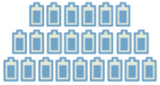
Investment Rationale
TSM to increase market share as industry consolidates with low chance of new entrants
The market share of competitors outside top 10 semiconductor foundries dropped to 0% in 2021
More market share to open in the future as R&D required to innovate smaller chips increases
Business model has high barriers of entrance as it requires $4B+ in initial cost and billions in R&D
From 2019-2021, TSM (+7.9%) and SMIC (+0.5%) were the only companies to gain market share
TSM’s technological and operational excellence positions themselves to capture market share
3D stacking technology allows TSM to continue innovating and offer more services
TSM’s SoIC technology is working to stack and link several different chips into one package
Google and AMD will be the first customers for SoIC chips and are helping to test/certify them
Full production planned for 2022 and will be used for autonomous driving systems and HPC
TSM to also grow back-end revenue from services including research and testing through SoIC
Market Share of the Top 5 Foundries
Advantages of TSM’s SoIC
 | 2D | 3D IC | TSM SoIC
Bonding density
Speed
Power Consumption
Sources: TSM, Earnings Call Transcript, Nikkei Asia, Statista

Slide 8
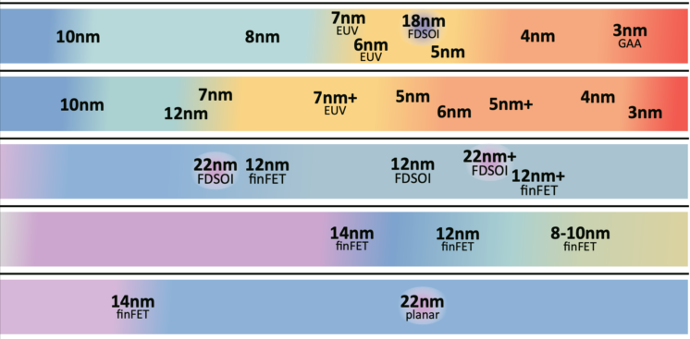
Competitive Advantage
Worldwide Semiconductor Foundries by Market Share
Foundry Roadmaps
 | 2016 | 2017 | 2018 | 2019 | 2020 | 2021E | 2022E
Samsung
TSMC
Globalfoundries
SMIC
UMC
Sources: Statistica, WCCFTech

Slide 9
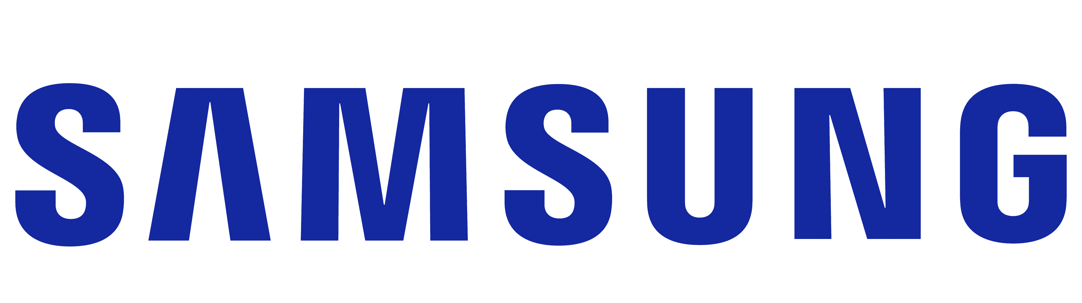
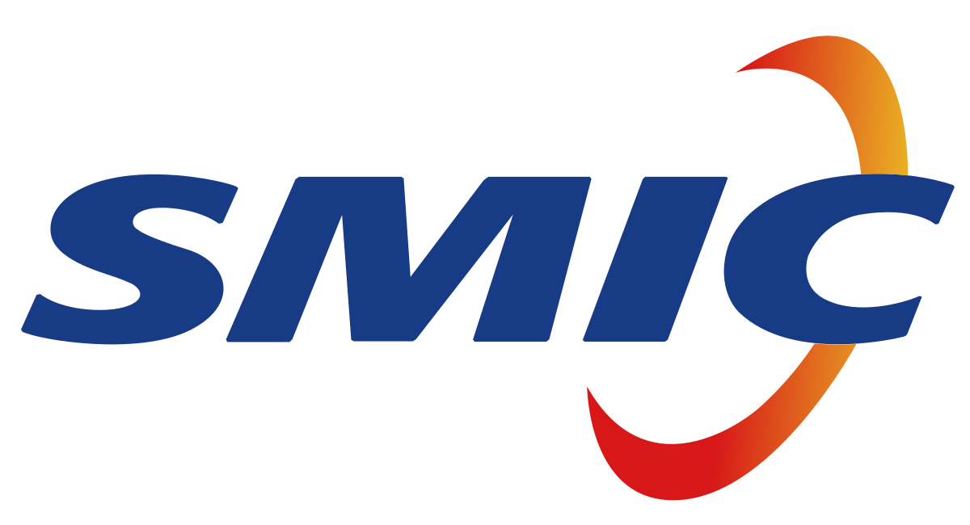
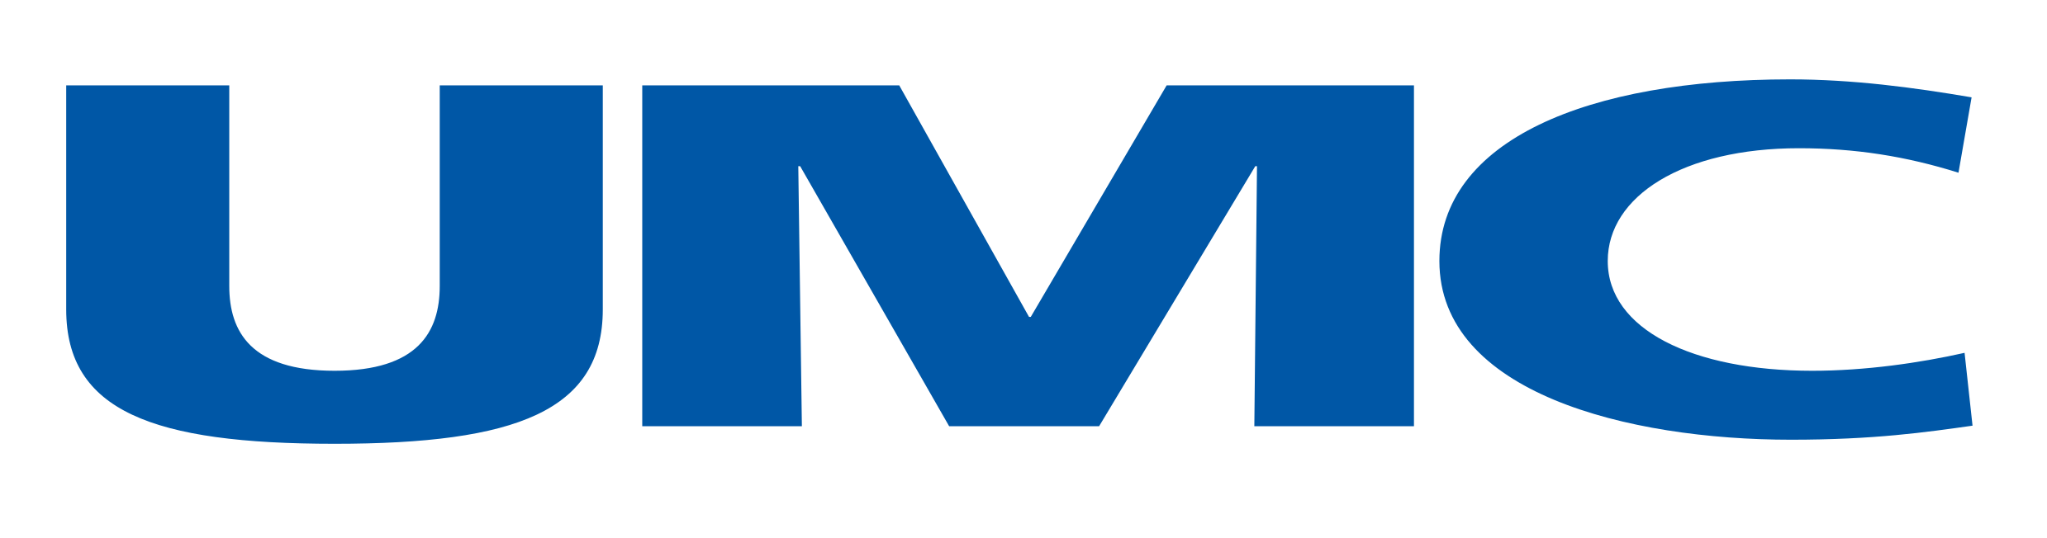
Competitive Landscape
Mkt Cap | $485B
Net Income | $41B
Beta | .91
Mkt Cap | $21B
Net Income | $1B
Beta | .89
Mkt Cap | $34B
Net Income | $347M
Beta | .49
Samsung is a South Korean producer of electronics that manufactures internally
Samsung’s foundry overall has 2.3x less capacity and 2.5x less revenue
Samsung has 4.0x less capacity at 5nm and 3.5x less with 7nm
TSM has 50% CapEx foundry increases from 2020-2021 compared to 32% for Samsung
Samsung has limited customers as 60% of their capacity is utilized internally
UMC operates as a semiconductor wafer foundry primarily in Asia while also manufacturing products in the solar energy and LED industries
UMC fabs are only based in china and 1 fab in Taiwan
UMC is manufacturing 14nm chips compared to TSM at 3nm
UMC R&D expenses were $437M vs. TSM at $4B UMC increased 10% compared to 24% by TSM
SMIC is an investment holding company, engaged in integrated circuits and other semiconductor services
In China, SMIC is the only mass producer of 14nm wafers (4 years behind TSM)
SMIC’s total capacity for 8nm is 2.4x less than TSM
SMIC’s total capacity for 12nm is 6.9x less than TSM
SMIC was banned from accessing U.S. suppliers and technology
Sources: CAPIQ, Seeking Alpha, CNTechPost, MacroTrends

Slide 10
Public Comparables Benchmark
Inventory Turnover
LTM SG&A Margin (%)
Median: 3.8x
Median: 6.0%
LTM Net Income / R&D Expense
LTM Net Profit Margin (%)
Median: 2.0x
Median: 18.9%
Sources: CAPIQ

Slide 11
Public Comparables

Slide 12
Historic Exit Multiple
TSM vs. Median Consensus Historic EV / EBITDA Multiple
Sources: CAPIQ

Slide 13
Valuation
$156.25 (+43%)
$126.45 (+16%)

Slide 14
DCF

Slide 15
DCF Output

Slide 16
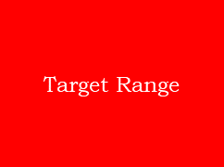
Football Field Analysis

Slide 17
Potential Risks & Mitigants
China’s increased influence on state-owned enterprises might influence the presence of competing multinational corporations in domestic and foreign markets
Mitigant: Global market share mitigates this risk as Taiwan, South Korea, Other, and then China own the market share of 63%, 18%, 13%, and 6% respectively
Mitigant: State backed enterprises have political, ethical, and more conflicts and as a result companies like SMIC were placed on an entity list, limiting the company’s access to technology and machinery
TSM may be limited in expansion and face more scrutiny due to their exposure to the Taiwanese economy
Mitigant: TSM announced plans for a domestic factory in Arizona. This project is valued at $12B and will receive United States federal subsidies
Mitigant: The Taiwanese economy is forecasted to grow 4.7% in 2021 and grew 3.1% in 2020 (outpacing China’s 2.3% expansion) and placing Taiwan as Asia’s top-performing economy
Mitigant: Taiwanese goods exports grew 4.9% in 2020 and are forecasted to row 9.6% in 2021
TSM’s revenue is largely tied into U.S. dollars so fluctuations between NT and other currency exchange rates can negatively impact them
Mitigant: TSM hedges currency risk with FOREX derivative contracts, which allows transactions at a set price and predetermined time
Sources: CNBC, NYTimes, Company Financials

Slide 18
Q&A

Slide 19
Appendix

Slide 20
Inputs

Slide 21
EV / EBITDA Valuation

Slide 22
Working Capital Schedule

Slide 23
Income Statement

Slide 24
Balance Sheet

Slide 25
Cash Flow

Slide 26
Currency Exchange Rate

